Slide 1


Generative AI for Beginners - .NET
A course for .NET developers diving into the world of Generative AI! This repository is all about real-world applications and live coding to empower .NET developers to take full advantage of Generative AI.
Bruno Capuano
aka.ms/elbruno | @elbruno
Start in less that 5 minutes here:
aka.ms/genainet

Slide 2
Generative AI for Beginners - .NET
A course for .NET developers diving into the world of Generative AI! This repository is all about real-world applications and live coding to empower .NET developers to take full advantage of Generative AI.
Start in less that 5 minutes here:
aka.ms/genainet

Slide 3

Generative AI for Beginners - .NET
A course for .NET developers diving into the world of Generative AI! This repository is all about real-world applications and live coding to empower .NET developers to take full advantage of Generative AI.
Start in less that 5 minutes here:
aka.ms/genainet

Slide 4
Generative AI for Beginners - .NET
Core Concepts:
GitHub Models
GitHub Codespaces
Local Models with Ollama
Azure AI Foundry
End-to-end Scenarios

Slide 5
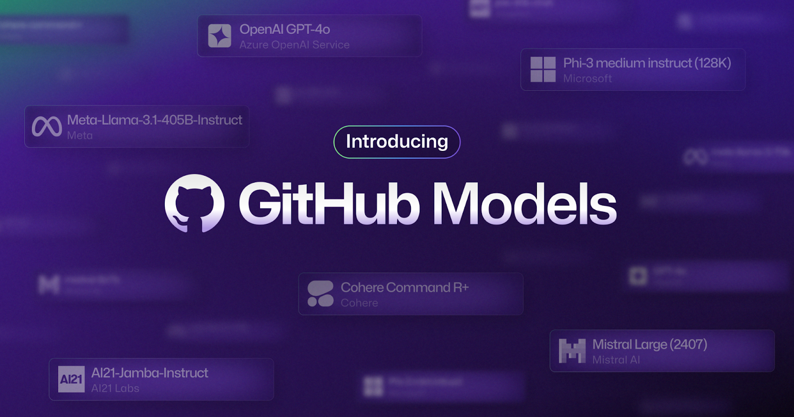

Slide 6
GitHub Models
We are enabling the rise of the AI engineer with GitHub Models–bringing the power of industry leading large and small language models to our more than 100 million users directly on GitHub.
In the new interactive model playground, students, hobbyists, startups, and more can explore the most popular private and open models from Meta, Mistral, Azure OpenAI Service, Microsoft, and others with just a few clicks and keystrokes.

Slide 7
GitHub Models
Experiment, compare, test, and deploy AI applications right where you manage your source code.
Spin up Codespaces to bring your ideas to life.
In alignment with GitHub and Microsoft’s continued commitment to privacy and security, no prompts or outputs in GitHub Models will be shared with model providers, nor used to train or improve the models.

Slide 8
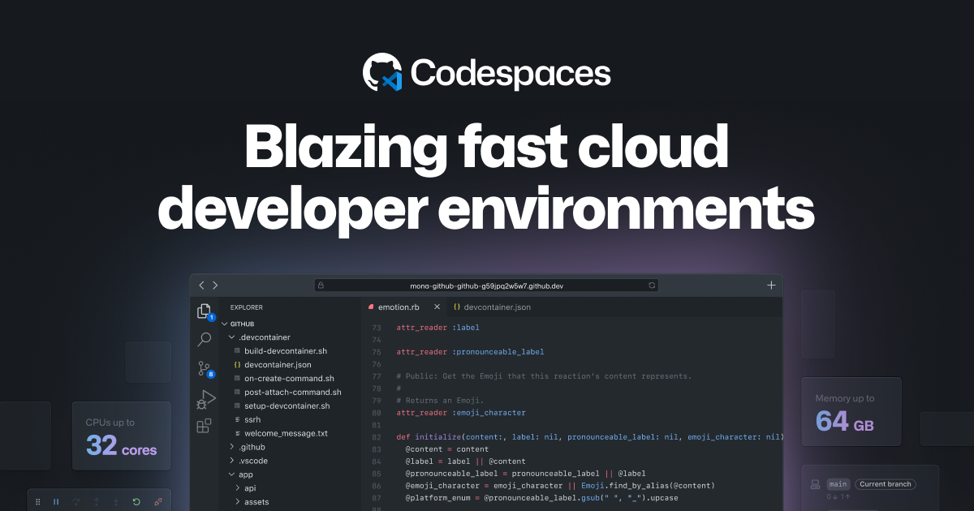

Slide 9
GitHub Codespaces
Write code, build your applications, run test suites, debug issues, and deploy all in your browser
Use web-based Visual Studio Code or your favorite IDE
Customize with extensions, settings, scripts, and features
Customize further using Docker and Docker Compose
Onboard new developers quickly with environments that are ready in minutes
Standardize developer environments within your organization
Distribute developer environment configuration as part of your demos

Slide 10
Demo

Slide 11
Core Generative AI Techniques
01
02
03
🌟 LLM completions and chat flows
🔗 Functions & plugins with LLMs
🔎 Retrieval-Augmented Generation (RAG)
04
05
06
👀 Vision-based AI approaches
🔊 Audio creation and transcription
🧩 Agents & assistants

Slide 12
Demo

Slide 13
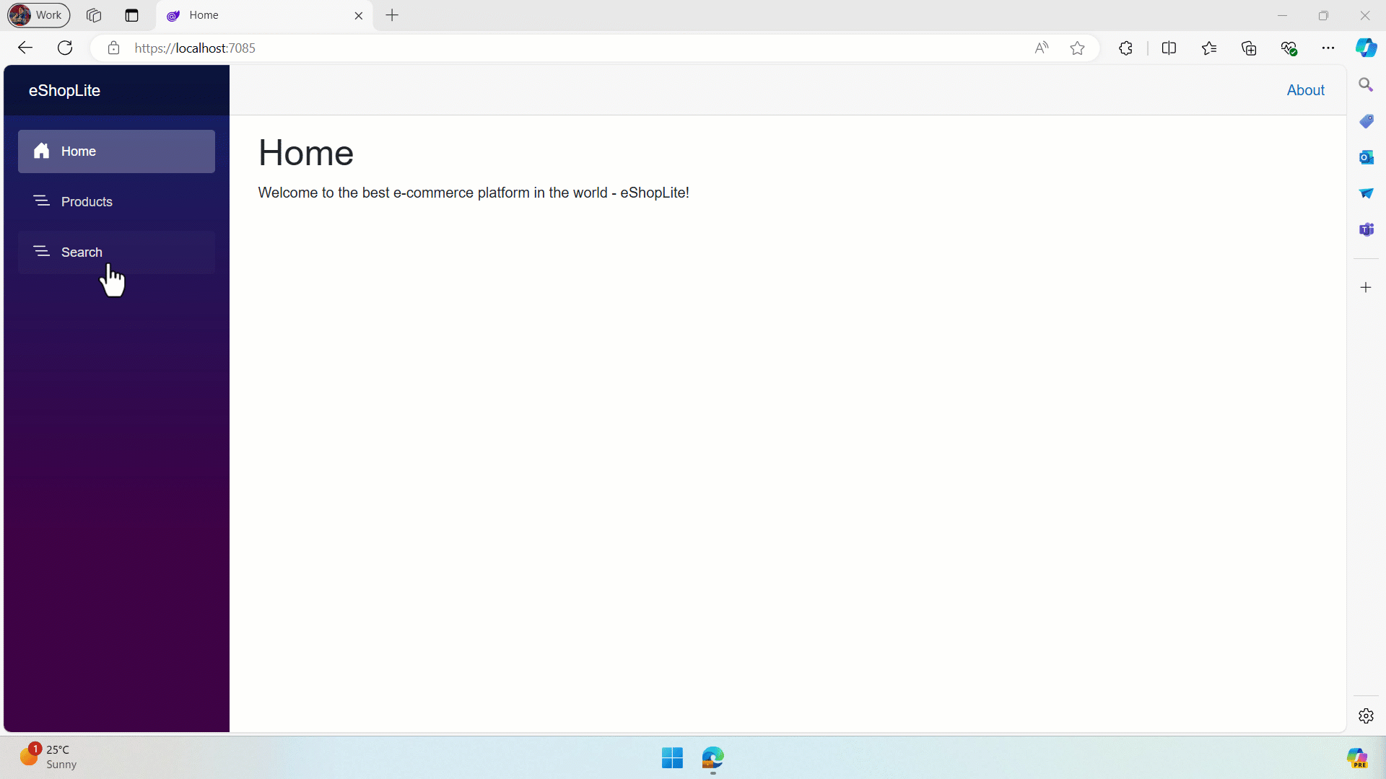
eShopLite

Slide 14
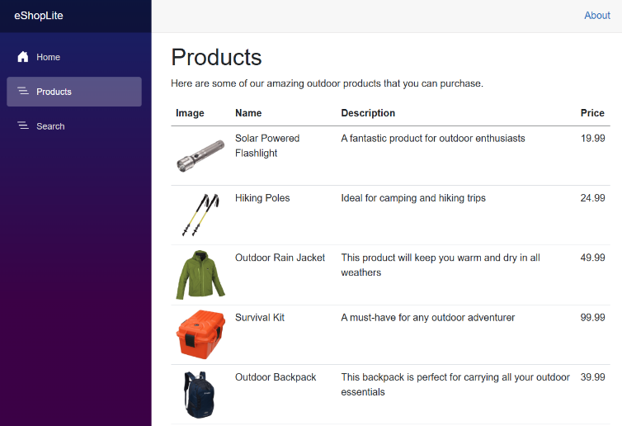
eShopLite Architecture
eShop Architecture
UI
Public web UI Blazor SSR
Backend
Minimal API
Storage
Relational DB SQLite

Slide 15
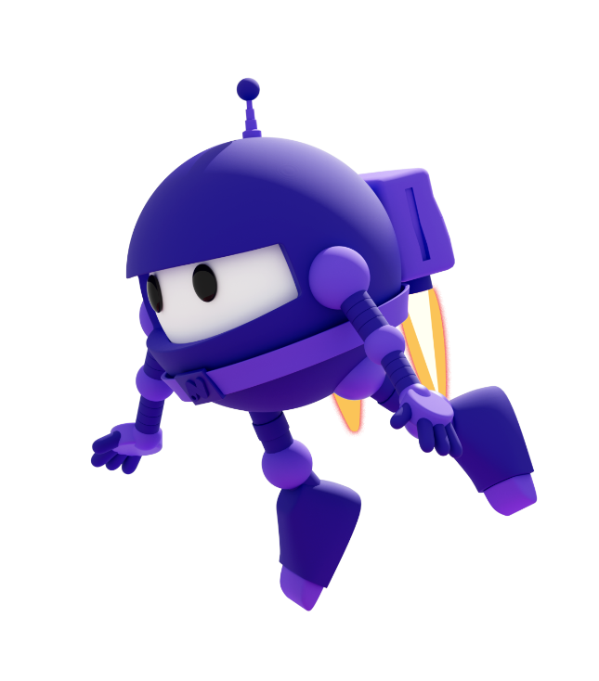



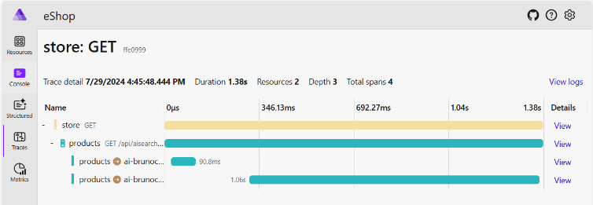
eShopLite Architecture with AI
eShop Architecture
UI
Public web UI Blazor SSR
Backend
Minimal API
.NET Aspire Orchestration
Developer Dashboard
Telemetry
Storage
Semantic Kernel Chat Services
Local Inference
Relational DB SQLite
LLM
GPT-4o
Vector DB
In-Memory
LLM
ada-002

Slide 16
eShopLite Semantic Search versions
In-Memory
Azure AI Search
ChromaDB
https://aka.ms/netaieshoplitesemanticsearch
https://aka.ms/netaieshoplitesemanticsearchazureaisearch
https://aka.ms/eshoplitechromadb
Realtime Audio
DeepSeek-R1
More …
https://aka.ms/eshoplite/realtimeaudio/repo
https://aka.ms/netaieshoplitedeepseekr1
https://aka.ms/genainet

Slide 17
Demo

Slide 18
Generative AI for Beginners - .NET
A course for .NET developers diving into the world of Generative AI! This repository is all about real-world applications and live coding to empower .NET developers to take full advantage of Generative AI.
Bruno Capuano
aka.ms/elbruno | @elbruno
Start in less that 5 minutes here:
aka.ms/genainet

